Slide 1



Introduction to Internet of Things & Embedded Systems
Name: koduru Manoj Kumar
Regd.No: 121710409023
Section: 4I

Slide 2


Contents
Introduction to Embedded Systems
What is Embedded Systems?
Applications of Embedded Systems
Arduino
Introduction to Internet of Things
What is Internet of Things?
How IoT Works?
Applications of IoT?
Project

Slide 3
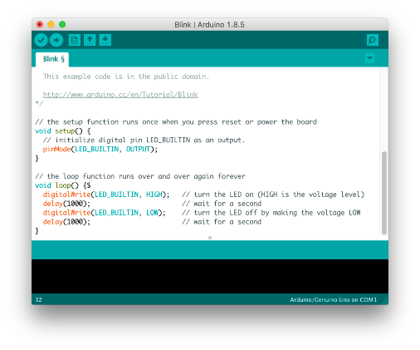
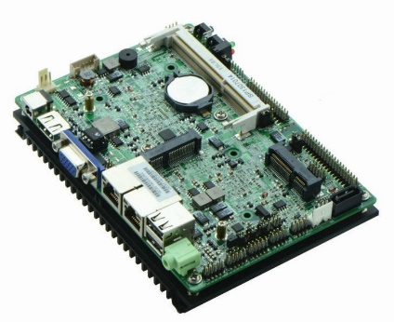
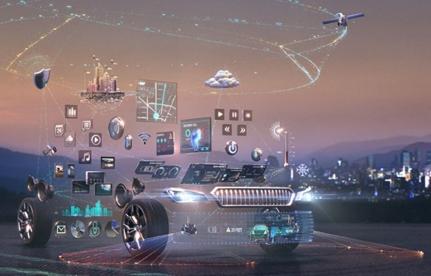
Embedded System
Embedded system is a combination of software and hardware such that it can fulfill the user requirement.
Software
Hardware
Application

Slide 4
Were the Embedded Systems Existing Earlier?
Yes, We have been enjoying the brace of Embedded system quite a long time. But they were not so popular because in those days most of the embedded systems were designed around a microprocessor unlike todays systems which were built around a microcontroller.
As we know a microprocessor by itself do not possess any memory, ports etc. So everything must be connected externally by using peripherals like 8255,8257,8259 etc. So the Embedded systems using microprocessor was not only complicated in design but also large in size. At the same time the speed of microprocessor is also a limitation for high end applications.

Slide 5
Applications Of Embedded Systems
Tele Communications – Wireless Communications, Mobile Computing
Smart Cards – Banking, Telephone
Automobiles – Engine or Body safety, Car Multimedia
Satellites & Missiles – Defence, Aerospace
Computer Networking – Image Processing, Printers
Digital Consumer Electronics – Digital Camera, Tv’s

Slide 6
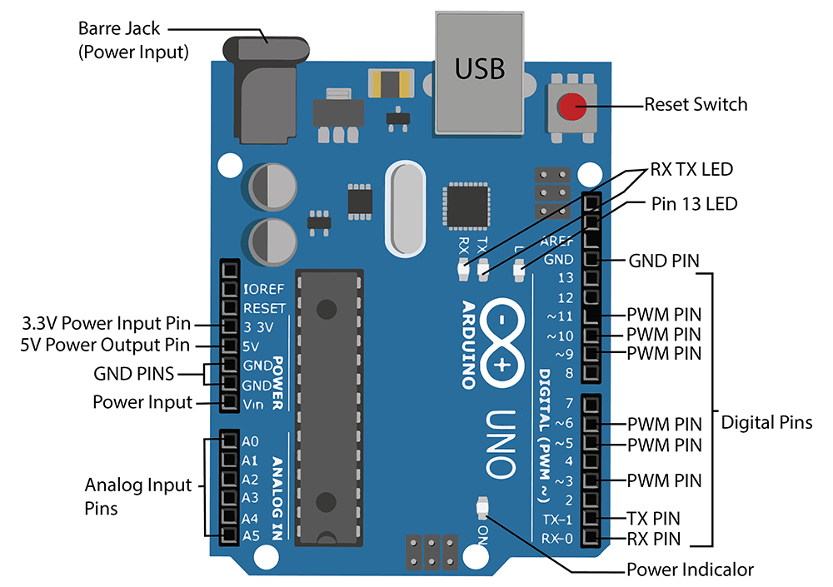
Arduino
Arduino is an open-source platform used for building electronics projects. Arduino consists of both a microcontroller and a piece of software, or IDE (Integrated Development Environment) that runs on your computer, used to write and upload computer code to the physical board.

Slide 7
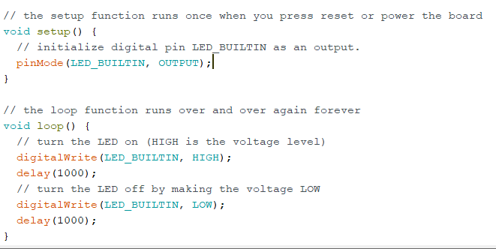
IDE (Integrated Development Environment)
Void setup() #initialization (executed 1 time)
Void loop() #While power is on, loop
pinMode(pin, MODE) #setup,MODE=Input,Output
digitalRead (pin) #returns 0 or 1
digital Write(pin, VALUE) #Value=High;Low / 0:1
AnalogRead (analogpin) #returns 0 to 1023(integers)

Slide 8
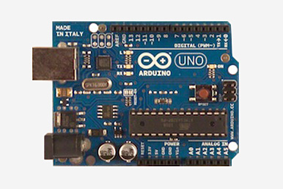
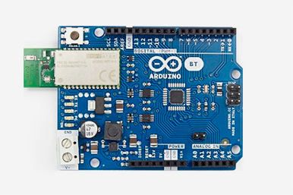
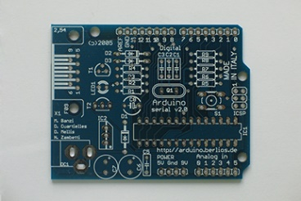
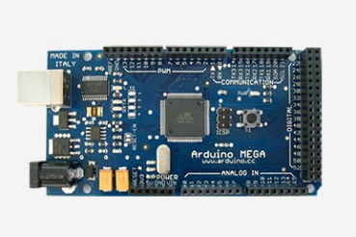
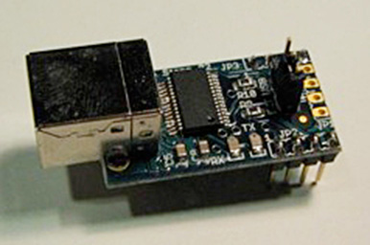
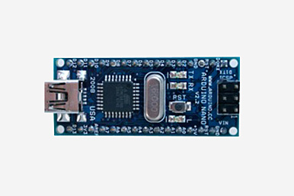
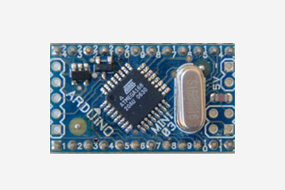
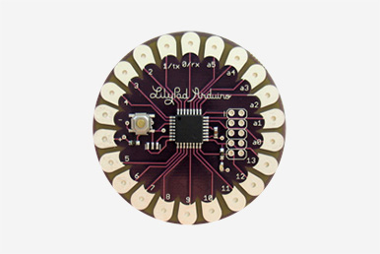
Different Versions of Arduino
ARDUINO UNO
Arduino Bluetooth
Arduino serial v2.0
Arduino Mega
Mini Usb Adapter
Arduino Nano
Arduino Mini
Arduino Lilypad

Slide 9
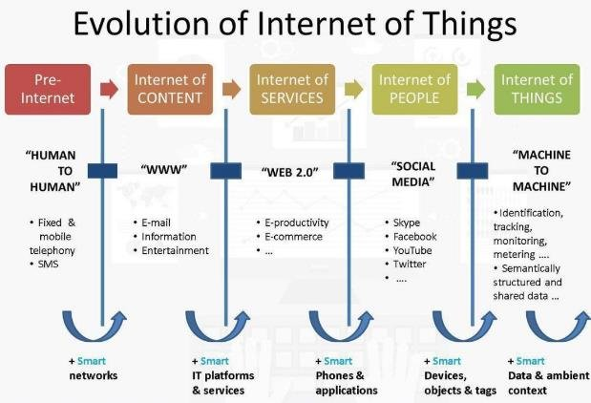
Internet Of Things
Internet of Things is an ecosystem of connected Physical Objects that are accessible through the internet.

Slide 10
How IoT Works?
Smart Tech
Nano Tech
RFID
Sensor
To identify and track the data of things
To collect and process the data to detect the changes in the physical status of things
To enhance the power of the network by devolving processing capabilities to different part of the network.
To make the smaller and smaller things have the ability to connect and interact.

Slide 11

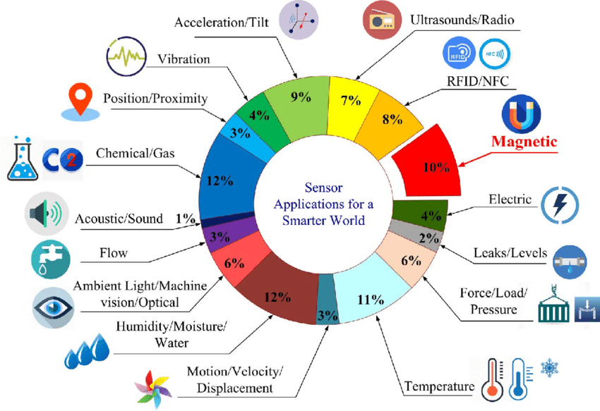
Sensors

Slide 12
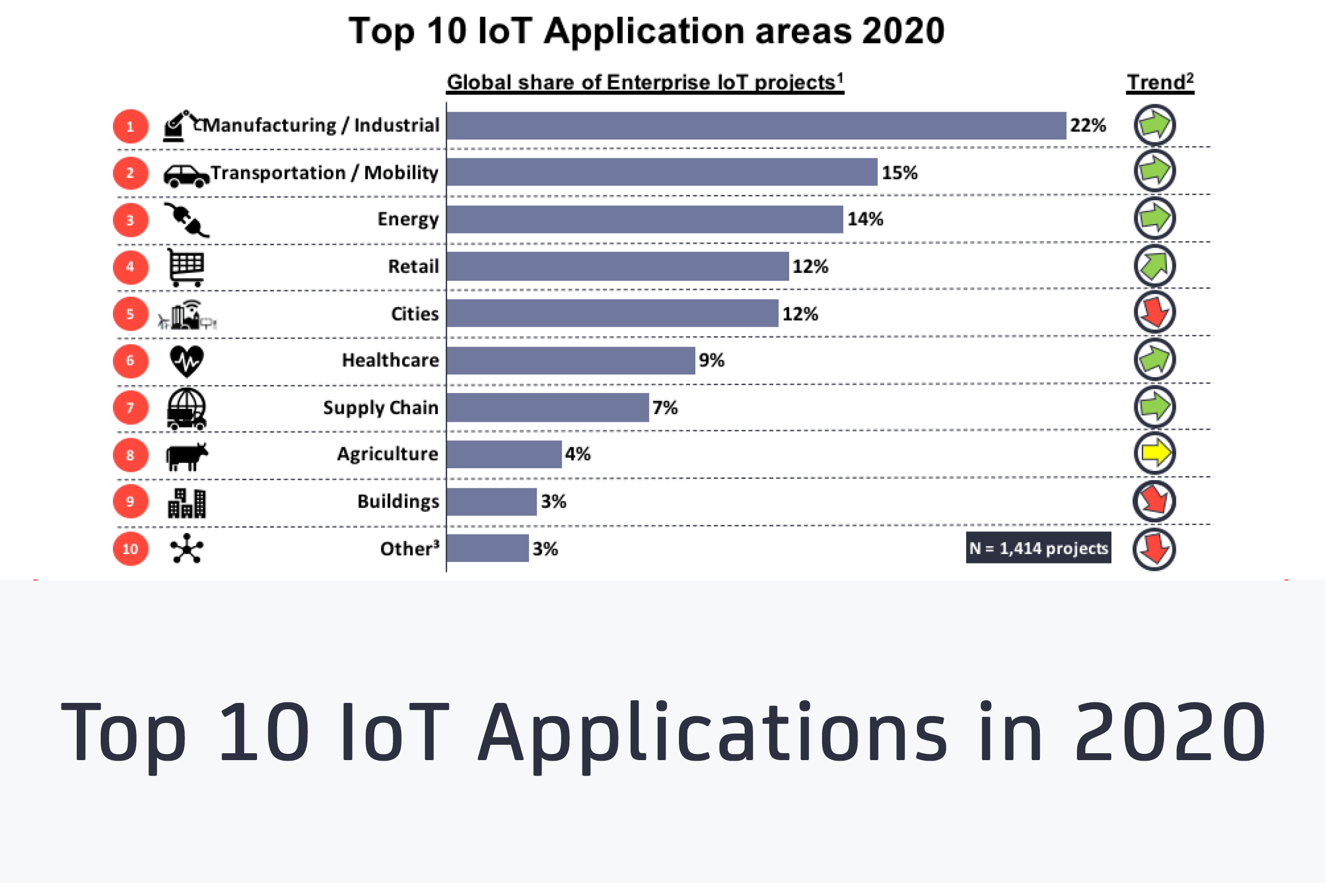
Applications Of IoT

Slide 13
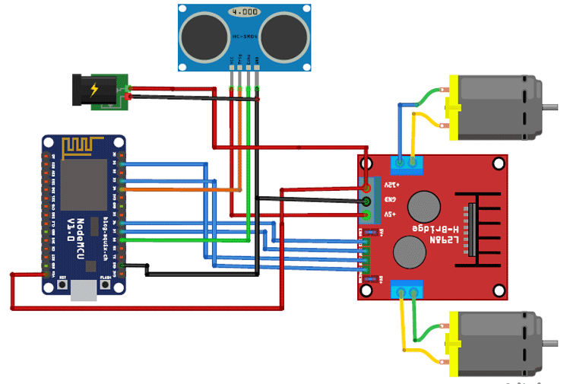
Project ( WiFi Controlled Robot)
In this project, we will learn how to control robot by using android device via WiFi. We will use the NodeMCU ESP8266-12E for this project. Also, we will develop the application using MIT App Inventor.
In the present day, technology has so improved that an Unmanned Aerial Vehicle (UAV) also called as Drone can be controlled from a distance ranging from 2km to 20,000km. The Mars Rover, which was sent to Mars to explore various features of the planet is an autonomous robot which is programmed such that it performs the desired task as it is intended to do. There are many such systems which are controlled either by Radio Frequency transmission or by creating intelligence. Robots are called Nonautonomous robots. These robots have the programming logic to do the desired task but the decision power lies in the hand of controller (human) handling the robot. Here the interface can be made using two methods:
A. Wired –The connection between controller and robot is maintained using wired interface. This interface can be serial or parallel but the technology is transmission of signal, which is sent in the form of specific pattern to the robot to carry out the specific task, these patterns with the help of a microcontroller governing its motion.
B. Wireless –Here the connection between controller and robot is achieved by wireless interface such as: ➢ Bluetooth ➢ Wi-Fi the underlying technology is transmission of signals wireless in air by transmitter which is captured by the receiver and sent to microcontroller mounted on the robot to carry out the task. At the present demand for robots in this developing world to carry out work effectively and accurately, the development of cost-effective robots is necessary.

Slide 14
